Slide 1
Water System Service Areas and Environmental Justice Analysis of Drinking Water Quality
Presented by Tina Bardot, ORISE Fellow
In collaboration with Wes Austin and Ahmed-Rachid El-khattabi
Notes:
Hello everyone, my name is Tina Bardot. I am an ORISE fellow at NCEE, and today I will be presenting on a research paper in a collaboration with Wes Austin of NCEE and AR El-khattabi of the University of North Carolina, in which we explored environmental justice in the context of public drinking water systems in the US.

Slide 2
Introduction
The service area problem: Lack of national, reliable, high-quality data on the geographic extent of public drinking water systems (“service area boundaries”)
Implications for environmental justice:
Difficult to evaluate relationship between drinking water concerns and higher social vulnerability (e.g., racial minorities and low-income populations)
Notes:
As a quick intro, the main problem we’re facing is a lack of nationally consistent and reliable data outlining the geographic extent of service area boundaries, which encompass “where” public water systems are, and whom they serve. Because of this, it is difficult to evaluate potential environmental justice concerns associated with drinking water quality, as we do not have a good sense of which populations are impacted when a public water system experiences water quality issues.

Slide 3
Comparing existing service area boundaries
We compare the 5 existing approaches* for approximating service area boundaries nationally:
County served
Zip code served
United States Geological Survey (USGS)
Environmental Policy Innovation Center (EPIC)/ Simple Lab state and modeled boundaries
Hall & Murray’s (EPA/ORD) boundaries
Notes:
In our paper, we compare the 5 existing approaches for approximating service area boundaries nationally, outlined here.

Slide 4
Drinking water quality indicators
We create 5 drinking water indicators :
Health-based violations of the Safe Drinking Water Act (count)
Lead Action Level Exceedances (count)
PFAS detections (count)
Disinfection Byproducts concentrations (sum)
Total Coliform Rule detection shares (proportion)
Notes:
And across the aforementioned service area boundaries, we compare different measures of drinking water quality. Today, I will mainly focus on our results regarding health-based violations of the Safe Drinking Water Act, where we aggregated the count of distinct violations for a public drinking water system between 2015 and July 2023.

Slide 5
EJ analysis
Compare socio-demographic categories related to environmental justice:
% People of Color
% individuals with income below twice the Federal Poverty Level
Develop relative risk ratios for drinking water quality concerns
Compare relative exposure to drinking water quality indicators
Compare ratios across boundary estimation approaches
Does the boundary affect EJ conclusions?
Notes:
To conduct our environmental justice analysis, we focused on two socio-demographic categories: race and income. In our paper, we develop relative risk ratios, where we compare the estimated exposure to drinking water quality issues based on the service area boundary method employed to test whether they might lead to different conclusions about Environmental Justice.

Slide 6
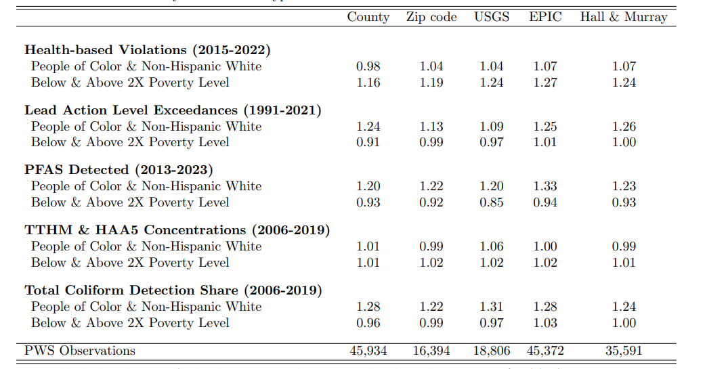
Relative Risk ratios
Notes:
While there is a lot going on is this slide, I will focus on the top row to highlight one point of our paper. If the relative risk value is equal to one, then a non-Hispanic White person and a person of color are equally likely to experience health-based violations in their drinking water system. What we see here is that, depending on the service area boundary method, we might come to different conclusions regarding relative risk, as the county service area boundaries suggest a lower or near equal relative risk, whereas the others suggest a higher relative risk for the people of color category.

Slide 7
Mapping drinking water quality
Produce bivariate national and state maps at the Census block group level
highlight patterns in drinking water quality
Differences across indicators, relative to race and income

Slide 8
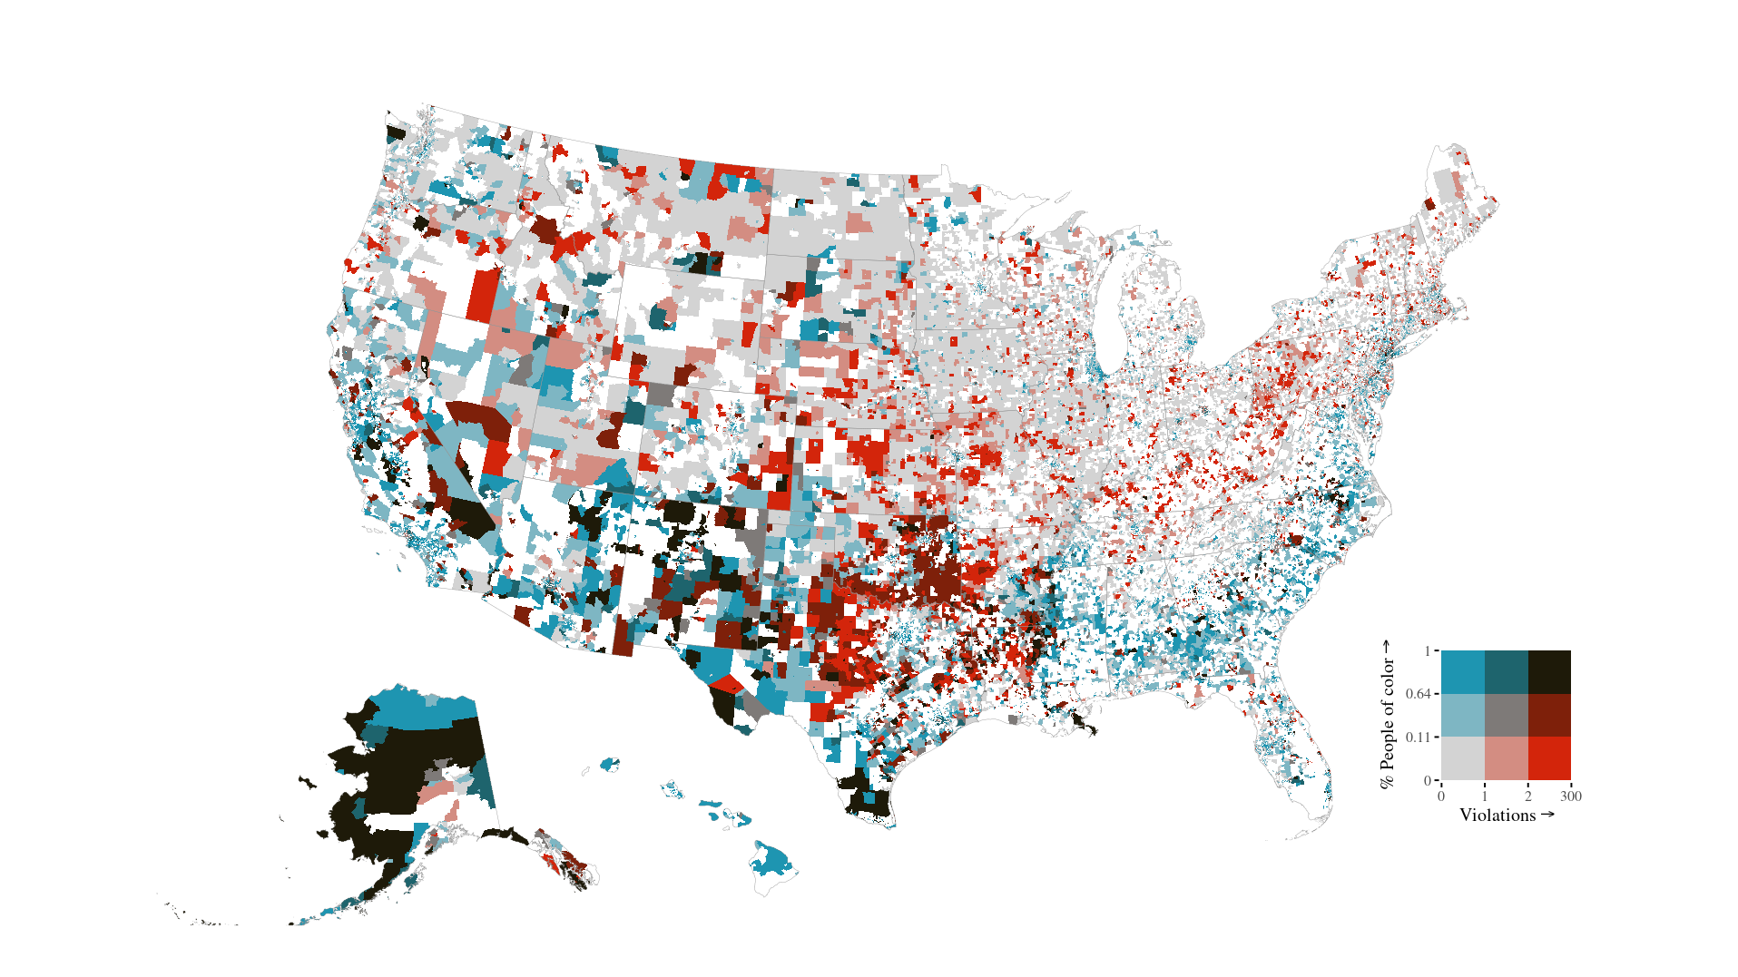
Health-based violations and % POC
Darker red = more violations & higher % POC
Notes:
We also use this data to develop state and national bivariate maps showing the relationship between different indicators and the two demographic categories. Here, I am showing how the number of health-based violations are related to the percentage people of color at the census block group level. I’ll note Alaska, which has a high % American Indian population, and southern Texas, which has a high % Hispanic population.

Slide 9
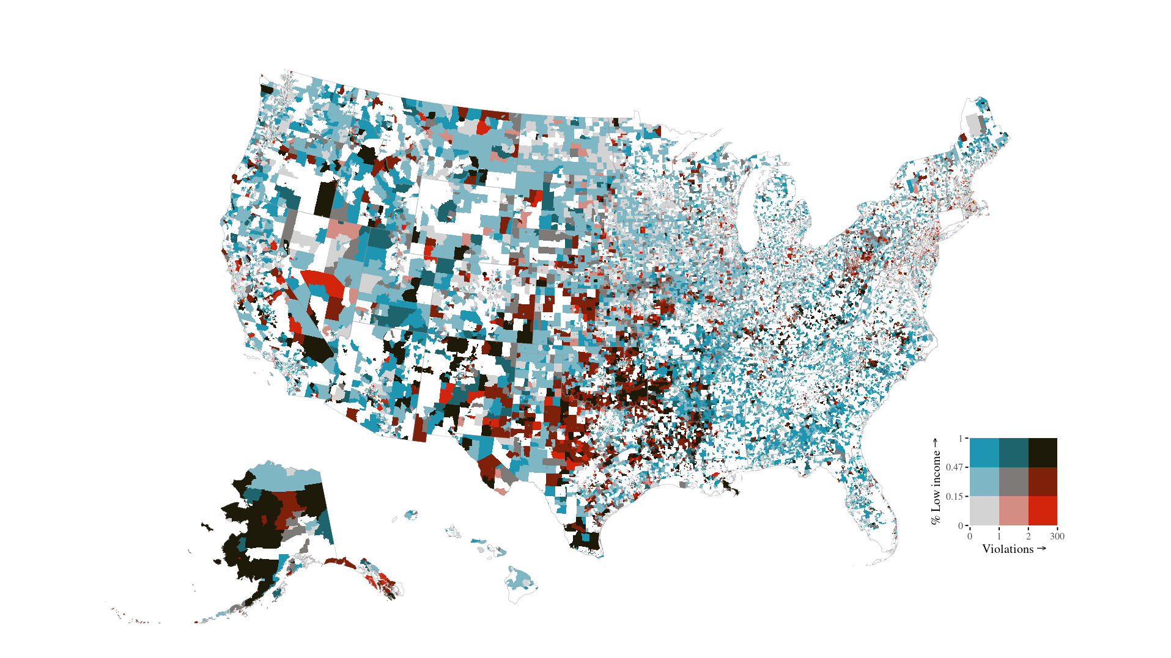
HB violations and % Low income
Notes:
Here is a similar map, using the percent low income as the demographic category.

Slide 10
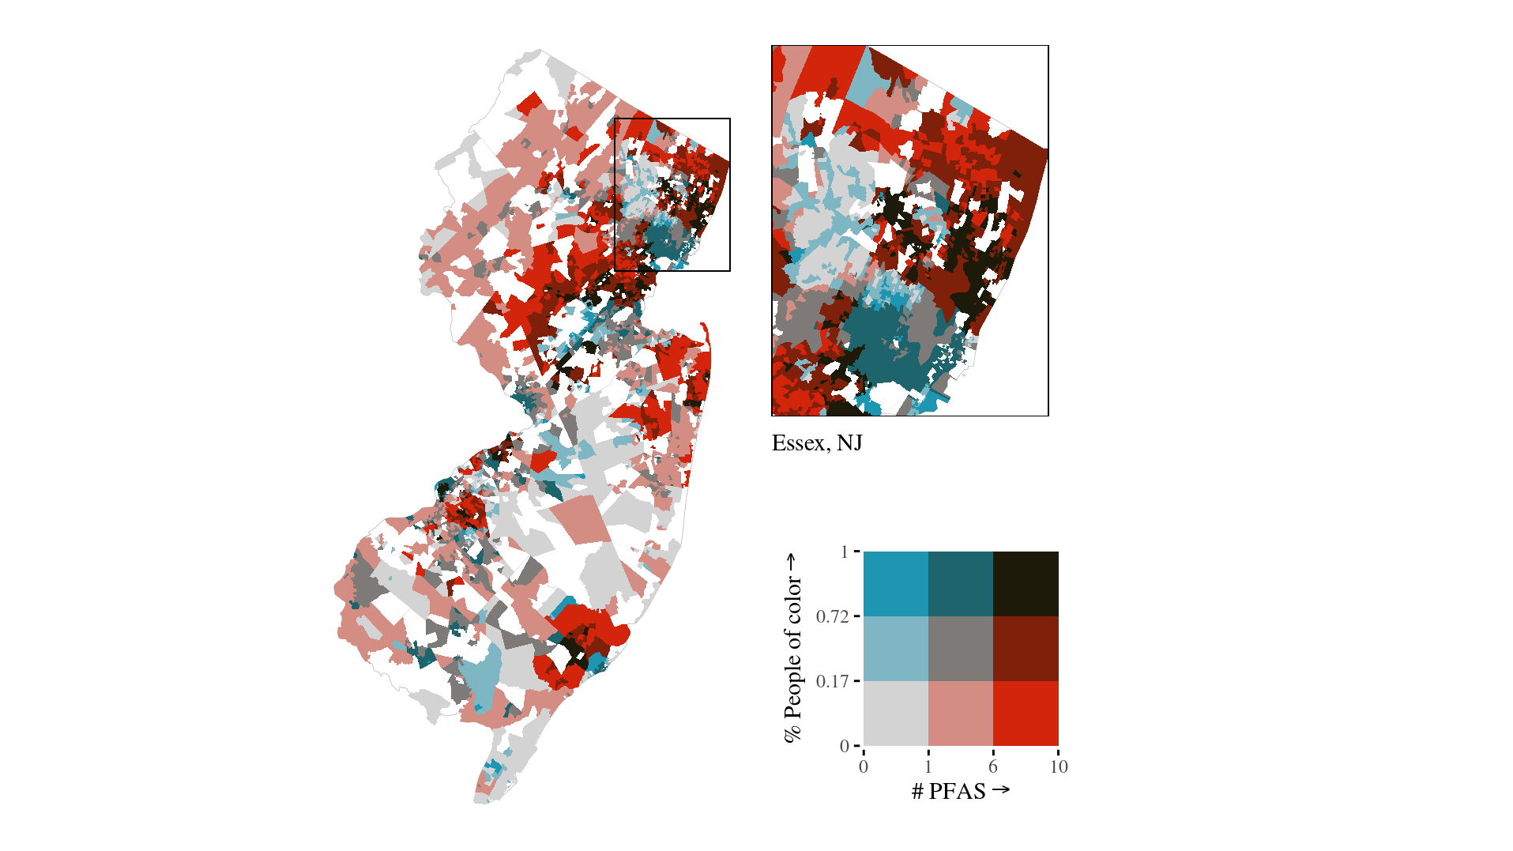
New Jersey: PFAS detected
Notes:
We also explore state-level relationships between drinking water quality and demography. Here is a map highlighting the relationship between the count of PFAS detected and the percent people of color in New Jersey.

Slide 11
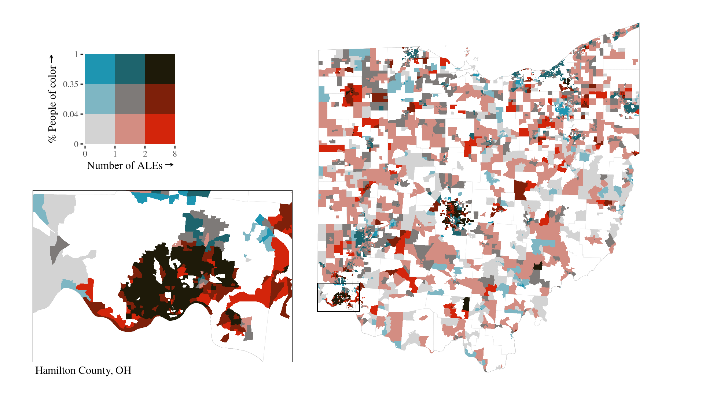
Ohio: Lead Action Level Exceedances
Notes:
OMG Cincinnati

Slide 12
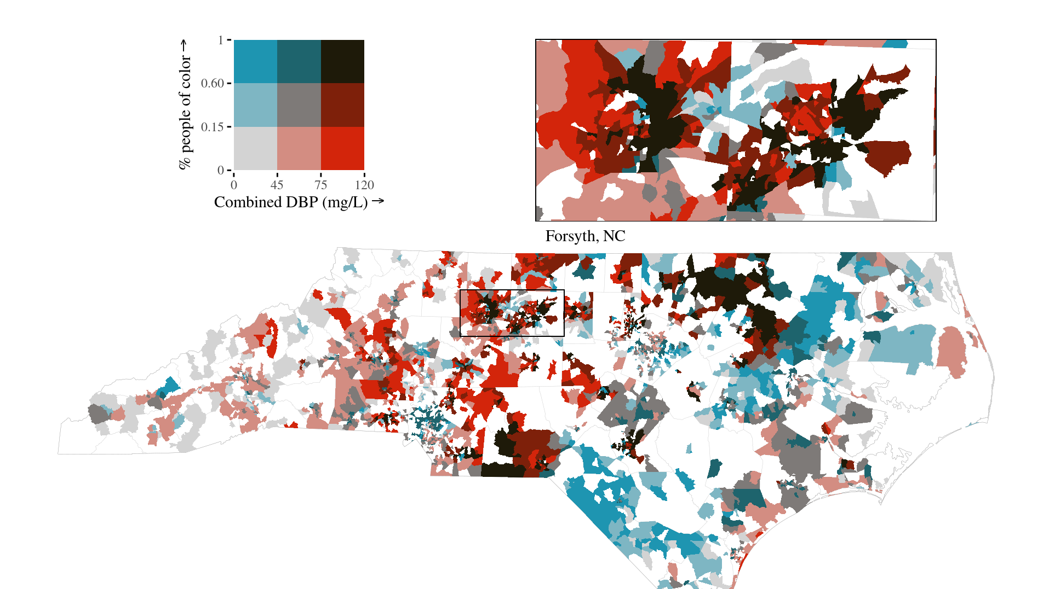
North Carolina : DBP

